Slide 1

GROWING TOGETHER SURVEY, ACTION PLANNING-2022-23
EMPLOYEE ENGAGEMENT ACTION PLANNING LINE MANAGER TOOLKIT
Tools and resources for discussing employee engagement results and creating an employee centric and employee generated action plan for improvement

Slide 2
EMPLOYEE ENGAGEMENT ACTION PLANNING TOOLKIT PROCESS SUMMARY
This toolkit is designed to help integrate the priorities and initiatives you and your team will be working on.
The goal is to leverage your employees’ engagement to create an employee centric workplace that focusses on employee
feedback to create a great workplace.
A simple timeline is detailed below. Please work with your team to complete the action plans within the next 4- 6 weeks.
Impact planning concludes for divisions and departments and communication about divisional priorities to employees
By 15th Feb
Line manager Access to reports
TTT for Line managers for impact planning
Closure of all action planning on system
TTT for HRBP for impact planning
9- 20th Jan
₁₁th
Jan
March, 2023
Mid Jan- Feb, 2023

Slide 3
OBJECTIVE
Why action planning is critical to this process?

Slide 4

OBJECTIVE: ACTION PLANNING PROCESS
The most important part of the employee engagement survey process is collaboratively creating a team action plan.
The action planning process includes multiple steps to ensure that these plans are deliberate and effective.
In order to improve your team’s work environment and maximize performance, all team members must feel they can contribute to continuous improvement.
The process outlined in this toolkit will help you bring in multiple findings to generate a meaningful discussion; however, the best engagement discussions are those that are open, encouraging, and two-way.
Keep in mind to keep the teams’ action plan alive during the year, communicate and follow up regularly with the team
on progress.

Slide 5
Step 1:
Interpreting the results and getting ready for the discussion( before 15- Feb, 2023)

Slide 6






STEP 1: INTERPRETING THE RESULTS (before 15th Feb, 2023)
1
Start by going through the dimension scores and analyze your scores w.r.t to your own scores from 2019 till date. You may also compare your scores with regards to the Group overall scores and the external benchmark provided.
90% and Above | Very Favorable
80-89% | Favorable
70-79% | Moderate
Below 70% | Unfavorable
2
You may also slice the data with various cuts such as gender, age groups,
countries, brands etc. to get granular in your analysis
Top 10 statements help you understand your areas of great work and bottom 10 statements signify areas where you may need to start putting your focus.
3
You may use delta from previous year or group average scores, on the
individual questions, to gain a deeper understanding.
4
All color shadings on the dashboard and heat maps are relative to the Group scores. The more negative deviation the color tone turns red and shades of red and with more positive deviations the color tone turns green and shades of green.

Slide 7
Step 2: Self Reflection
QUESTIONS TO CONSIDER FOR SELF

Slide 8

SELF REFLECTION
ASK YOURSELF:
How am I feeling about my team results?
Are they coming as a shock or was I expecting them?
Are the results reflective of where we have put in efforts last year?
Did I discuss action plan areas with my team last year?
How were accomplishments communicated to employees?
What accomplishments deserve recognition?
What is the story I am telling myself about the team results?
Am I taking the results personally?
What do I need to do to get myself into the right headspace to drive a constructive conversation?
ASK YOUR TEAM ( If it helps you to reflect better):
What do you need from me to be more successful?
What are ways that important decisions could be communicated more effectively to you?
What can I do to provide better feedback

Slide 9
Step 3:
Getting ready for this discussion( between Feb- mid March)

Slide 10
Sample Agenda
TIME | AGENDA ITEM | RESOURCES | RESPONSIBLE
5 Min | Welcome and outline objective of the meeting Thank your team for their time and open feedback on the employee engagement survey. Explain that the purpose of this session is to further discuss the employee engagement results and other areas of opportunity for your team to enhance engagement further, through a team action plan. Ensure that you create an open and trusting environment. Highlight that this is a safe space, where concerns and observations can be raised. |  | Line Manager
15 Min | Current Results discussion Sharing of key divisional and departmental results, highlighting the key strengths and concern areas coming forward. Share Team key results Review each area of opportunity and generate a discussion | Slides with key results you wish to focus on. | HRBP Line Manager
20 Min | Engagement Results Deep Dive and Identifying top areas of opportunity: Ask each team member to share what they believe the top 2 areas of opportunity are for the team (where they would like to see the team improve). Document all findings and generate a consensus around 3-4 areas of focus. Highlight areas that seem to be running across the Division, and also those that are unique to the team. | Flip chart & Markers | HRBP Line Manager
20 Min | Develop Action Plan Ask team members to generate ideas for action items around the areas of focus As a team select 3- 4 final action items You might wish to identify an employee champion for each item (this also enhances engagement & development) Ask employee champion to prepare a suggestion for the final action item (wording, outcome and completion date) and give it to you after the meeting. | Flip chart & Markers | HRBP Line Manager
15 Min | Close and Thank You! Review the final outcomes with the team Discuss specific next steps Thank them for their time. |  | HRBP Line Manager
Document on Qualtrics and KPI’s 1. Close your action plan on Qualtrics

Slide 11
SHARING CURRENT RESULTS- HOW TO HAVE AN EFFECTIVE CONVERSATION?
Be Open: Take feedback on board constructively, even if it is tough, approach it with curiosity to understand better. Paraphrase what you heard in a positive way, to ensure that you understood correctly.
Be Thankful: Thank employees for all feedback and suggestions no matter the quality
Don’t Interrupt: Be a facilitator and only interrupt for the sake of time
Empower: If an employee seems to be very passionate about something ask them to “champion” the idea or action
Tips for discussing the engagement results:
Thank and praise all employees for positive outcomes
Recognize those team members who have championed certain areas
Approach the lower scores, with curiosity. Think of this as an opportunity, trying to understand what needs to happen to drive those scores up.
At this stage avoid jumping in to:
Discuss why are the scores low
What happened to make them low
Did they improve from the last year?
What would it look like for our team if these scores were to be higher
What actions/ behaviors/ events / activities would make them positive?
How can we get from where we are now to positive scenario as discussed.

Slide 12

Engagement Results Deep Dive- How to have an effective conversation?
Lead a discussion about how your team did, what surprised them, the strengths/opportunities of the work
environment, and where they believe the team should focus their time to improve.
You may use the top and bottom 5 statements to generate discussion.
You could also use the delta from previous year or delta from group average to drive conversations
Tips for Discussing Employee Engagement Results:
Emphasize the confidentiality of the survey and the importance of getting feedback from the employees. This is a conversation, not a presentation. The objective is to move forward, not to know who said what in their survey.
If scores are less than 70%, encourage that next time we could do better; If above 80%, congratulate. It is not necessarily important to go through every item, but focus on top 5 positive, opportunity areas, and any important gap scores from the engagement reports.
Start off with what worked really well last year that we should continue doing this year? This will generally get the team talking.
A good way to start this discussion is asking what each question means to the employees, certain questions may have been interpreted in different ways, so it is important to gain the employees context of meaning.
It might be interesting to ask for the team to highlight the key pain points they experience around the topic
Ask employees what the workplace would need to look like in order for a question or gap to improve.

Slide 13
Effective Action Planning- How to have an effective conversation?
After discussing the results and identifying the 3-4 potential areas of opportunity, you should ask the team to
generate solutions.
Allow the team the space and time to brainstorm potential action. Keep in mind, that at the start, you are looking for quantity over quality.
  You can do this either by each member putting ideas on post-it notes (this works well if you have a number of quieter team members), or
  Having a team member act as a scribe and capture all the ideas that are being mentioned
Once all ideas are out, you might want to ask the team to aggregate any ideas that are similar or strongly related.
Ask the team to select, which from all the ideas provided do they believe, could give the best results.
Ask the team to elaborate those ideas further, to think of potential road blocks or support they might need to get the
results desired. What would great look like, how will success be measured.
As a team, don’t forget to discuss how everyone would like to be held accountable for the agreed on actions.
Ask for volunteers to champion each area of the plan. It will be the champion’s job to update the workgroup’s
progress every quarter.
Tips for Creating Action Plans
Ensure everyone is participating, and that the more assertive team members are allowing space for the more reserved ones.
Retain all ideas, and only start narrowing them down once all ideas have been captured.

Slide 14
Step 4:Document your actions on Qualtrics and keep track

Slide 15

Keeping a track of your action plan? How to ensure ongoing progress?
As the leader of the workgroup, it’s your job to keep the action plan on track. Use the below checklist on a monthly basis
to ensure that you are setting clear expectations, recognizing your employees, communicating the right messages, and
that your team is maintaining focus on and accountability to the team’s action plan.
https://www.qualtrics.com/blog/drive-accountability-action-employee-feedback/
Tips for Monitoring Ongoing Progress
Utilize multiple communication methods to reinforce progress (e.g., status e- mails, team meetings, quarterly team huddles etc. )
Recognize the team for accomplishing key milestones towards the goal –
celebrate in a way that is meaningful to them
Regularly check the pulse of the team on progress – ensure the goal is still
applicable– if it is not valid any more, adapt the goal to better meet the needs of the team.
Plan an update presentation to your leadership quarterly (1- May| 1- Sep| 1
Dec) to provide a status update to ensure accountability
If your team accomplishes their goals, revisit the current plan and develop new opportunities for improvement – keep the process alive throughout the entire
year
When discussing ongoing development, ensure the team knows it a top priority
for the team throughout the year

Slide 16
Qualtrics System

Slide 17
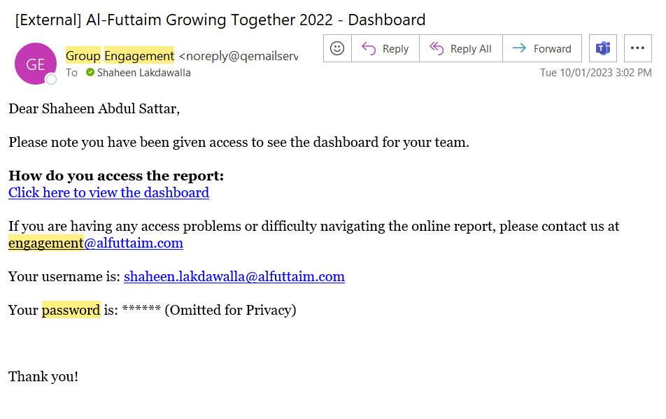

Slide 18
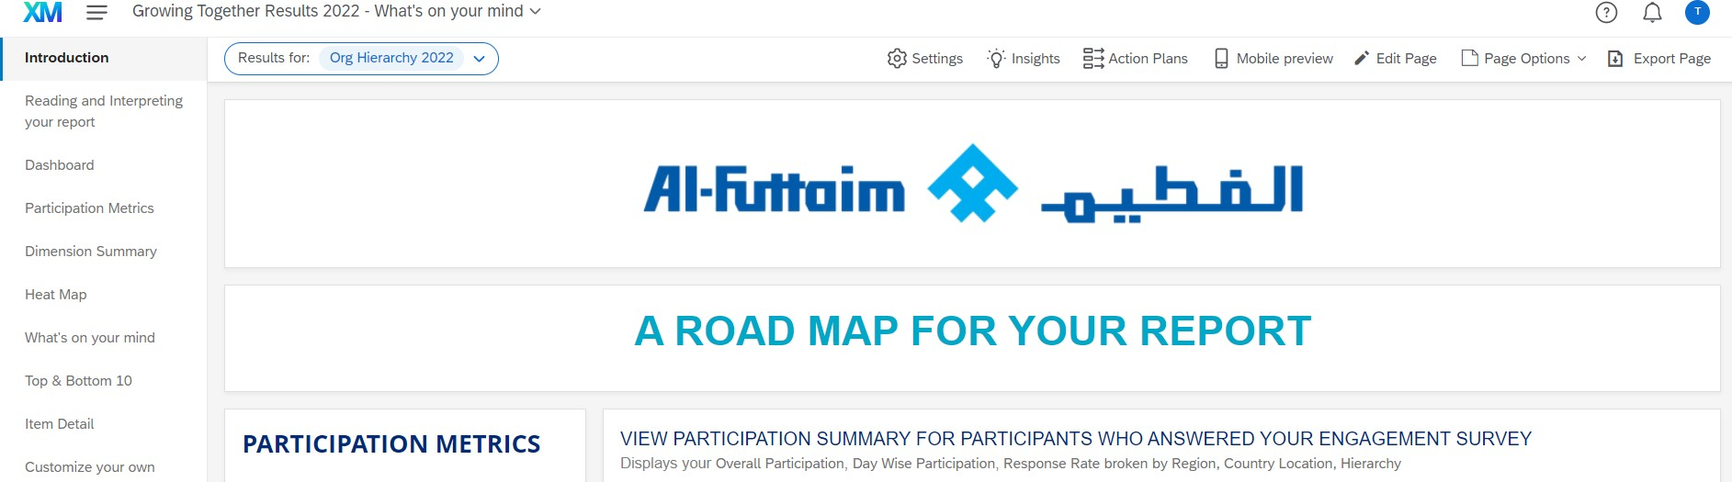
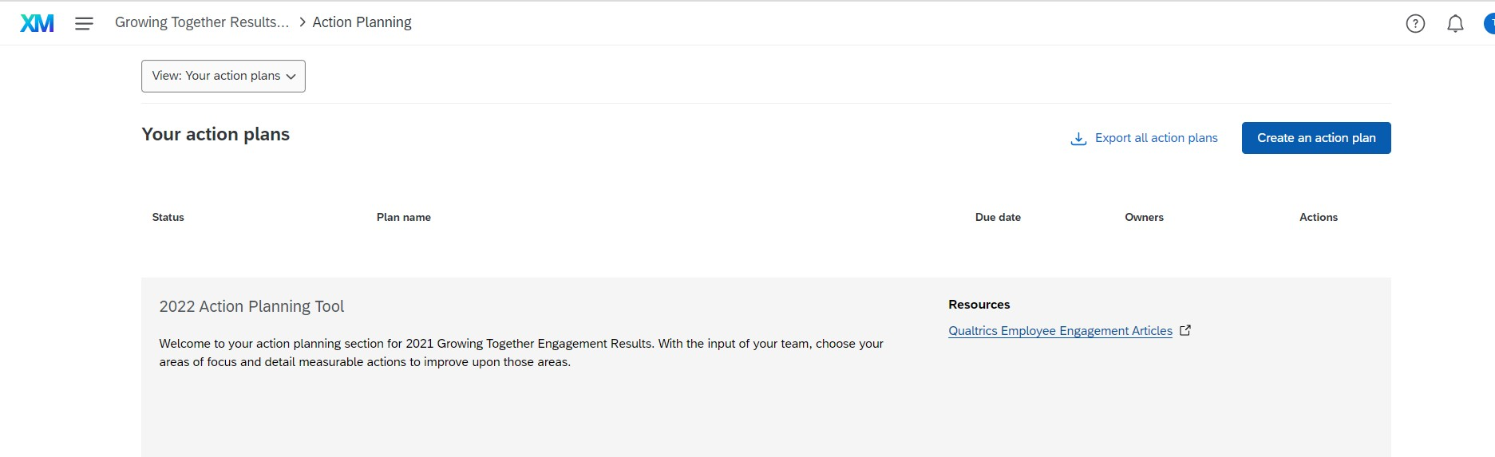
Document your action plan on Qualtrics

Slide 19
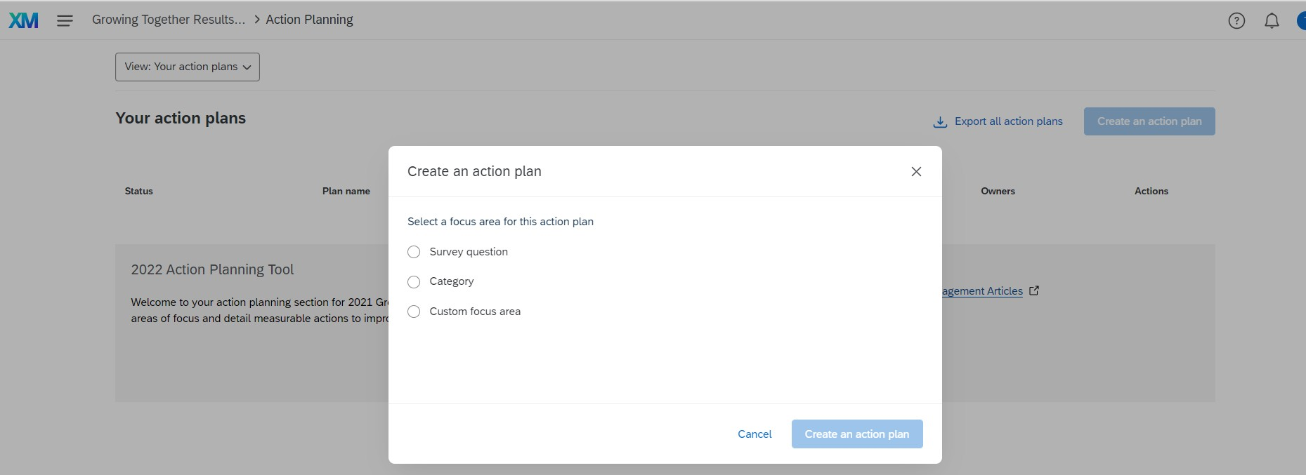

Slide 20
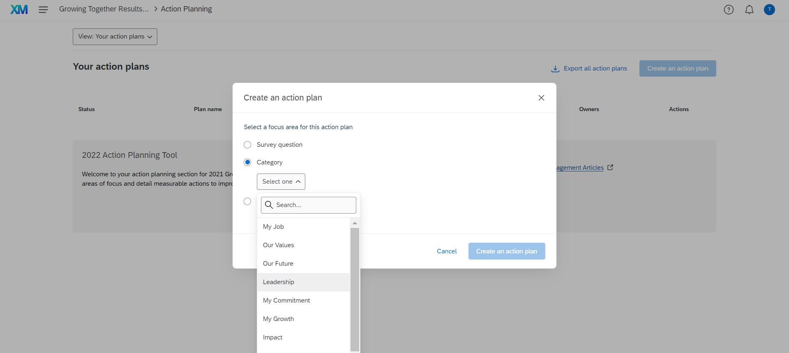

Slide 21
